Slide 1
Navigaton Controllers & TableView
TMA Training Center (TTC)
Course | iPhone application development
Trainer | Thuong Tran
Designed by | TMA Mobile Solutions (TMS)
Last updated | 25 Mar 2011

Slide 2
This section objectives
Understanding about Navigation Controllers and TableView in iPhone Development

Slide 3
Content
The Navigation Controllers
The Navigation Controllers Demo
TableView
Project assignment: implementation

Slide 4
The Navigation Controllers

Slide 5
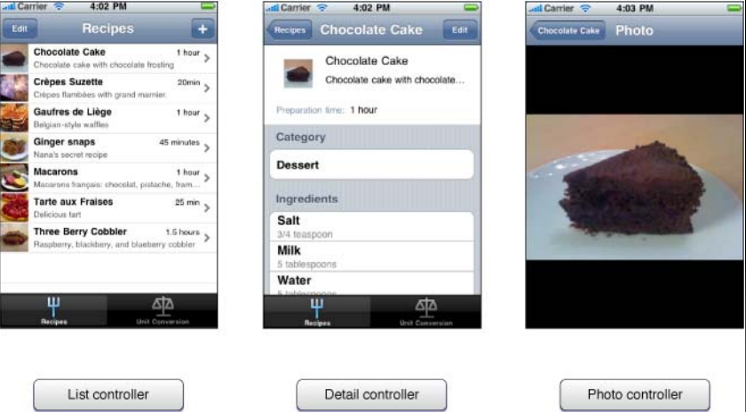
View Controllers

Slide 6
View Controller Types
There are three general categories of view controllers
  Custom View Controller: a controller object whose purpose is to display custom content
  Container View Controller: manages your other view controllers
    E.g. Navigation and tab bar controllers
  Modal View Controller: presented in a specific way by another view controller for a specific purpose such as input of data then goes away

Slide 7
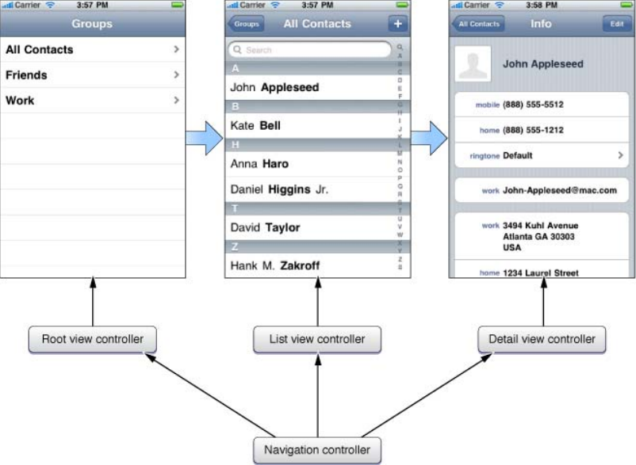
Navigation ViewController
• Don’t subclass
navigation controller
•Maintains a stack
of view controllers
• It does have views
such as nav bar and
back button

Slide 8
Navigation Stack Push/Pop
View controller push to stack
‐(void)pushViewController:(UIViewController *)viewController animated:(BOOL)animated;
View controller pop from stack
(UIViewController *)popViewControllerAnimated:(BOOL)animated;
Set to change the entire stack of view controllers available in > iPhone OS 3.0
‐(void)setViewControllers:(NSArray *)viewControllers animated:(BOOL)animated;

Slide 9
Pushing a View Controller
‐(void)applicationDidFinishLaunching {
// Create a navigation controller
myNavController = [[UINavigationController alloc] init];
// Push the first view controller on the stack
// We don’t want to animate pushing views when starting up the application
// Assume we had previously allocated and initialized a view controller
[myNavController pushViewController:myViewController animated:NO];
// Add the navigation controller’s view to the window
[window addSubview: myNavController.view];
}

Slide 10
User Actions Response
Push from within a view controller on the stack
Don’t call pop directly
  The pop is called whenever the user clicks the back arrow button
  Hooks into the ‘lazy’philosophy
‐(void)anAction:(id)sender {
// For example create a view controller and push onto the stack
UIViewController *aViewController = [[UIViewController alloc]
initWithNibName:@”TestNib”bundle:nil];
[self.navigationController pushViewController:aViewController animated:YES];
}

Slide 11
View Controller Title
Note that UIViewController includes a title property:
@property(nonatomic,copy) NSString *title;
Also note that the navigation controller picks up the title
The popped view controller’s title is displayed in the back arrow button
viewController.title = @“First Screen”;

Slide 12
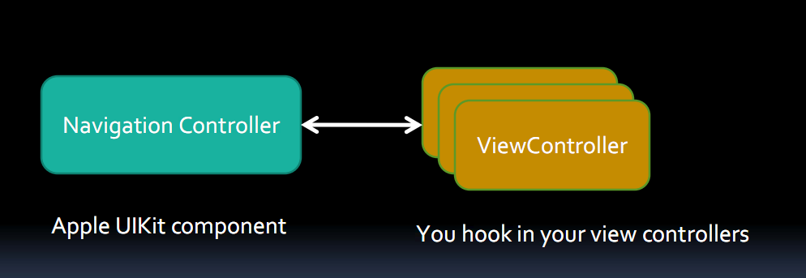
Container View Controllers

Slide 13
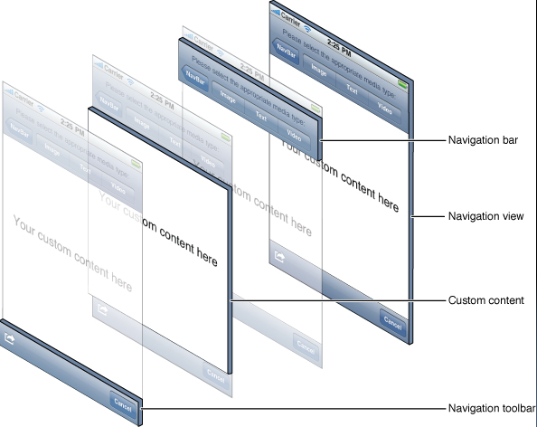
Navigation Toolbar
• Even though a
navigation controller
manages viewcontrollers
it also has views such as
nav bar and back button

Slide 14
The Navigation Controllers Demo

Slide 15
Exercise
Create a navigation controller project
  Root view have 4 button
  Click each button will bring to the second view controller with a label is your name of each button.
Create a tab-bar controller project
  Fist tab is navigation controller

Slide 16
TableView

Slide 17
TableView Basic
Tableview display list of data
  Each item in a table’s list is a row
  iPhone table have an unlimited number of rows
  iPhone table can be only one column wide

Slide 18
TableView class
UITableView: each table view is an instance of this class
UITableViewCell: each visible row of the table is implemented by this class. Each cell is responsible for displaying a single row of the table
Table views are not responsible for storing table’s data. They only store enough data to draw the rows that are currently visible

Slide 19
TableView delegate
Table views get their configuration data from an object that conform to the UITableViewDelegate protocol and their row data from an object that conform to the UITableViewDataSource protocol
- (UITableViewCell *)tableView:(UITableView *)tableView cellForRowAtIndexPath:(NSIndexPath *)indexPath
- (void)tableView:(UITableView *)tableView didSelectRowAtIndexPath:(NSIndexPath *)indexPath

Slide 20
TableView style
TableView in iPhone have 2 basic styles
  Group table:
    E.g: detail contact
  Indexed table
    E.g: list contact
Each division in your table is know as a section
  In group table: each section presents one group
  In indexed table: each section represents one index entry

Slide 21
Customize Table View
You can customize table view by customize each table view cell
There’re 2 ways to customize a table view cell
  Adding subviews to each cell
  Using a custom Subclass of UITableViewCell

Slide 22
TableView Demo

Slide 23
Exercise
Create a project have 1 table view, show names of 10 colors (each name have 1 color)
Create a project use tabbar – navigation – table view

